Slide 1
Capstone project(InstaSMart)
By
NAME : RHON JUDE
ID : 2154239

Slide 2
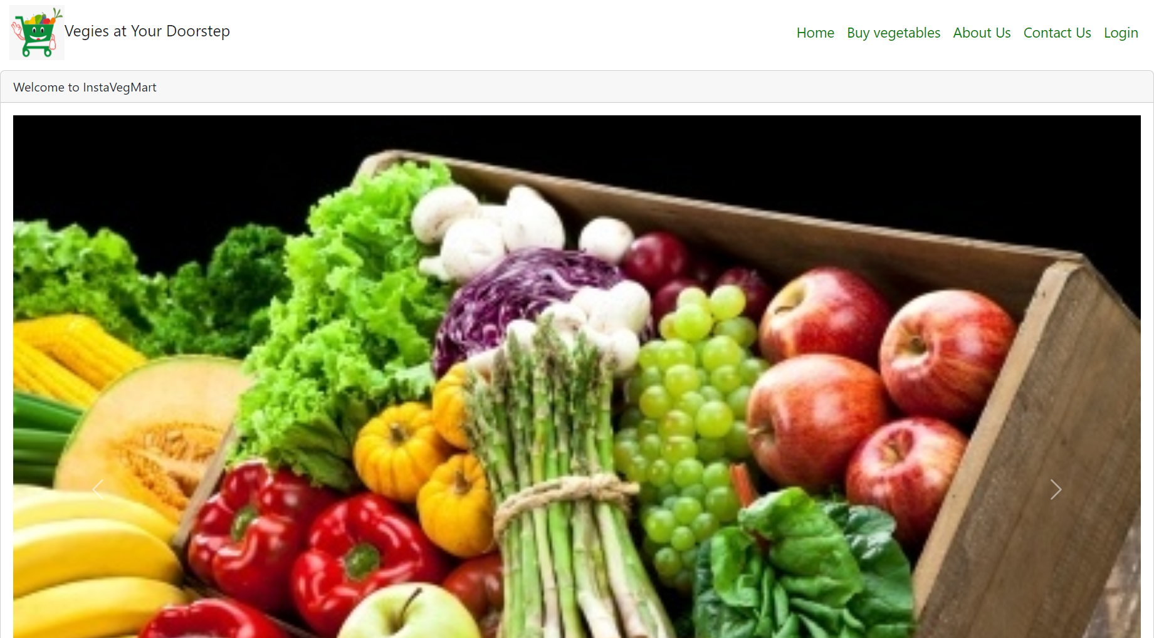
HOME PAGE

Slide 3
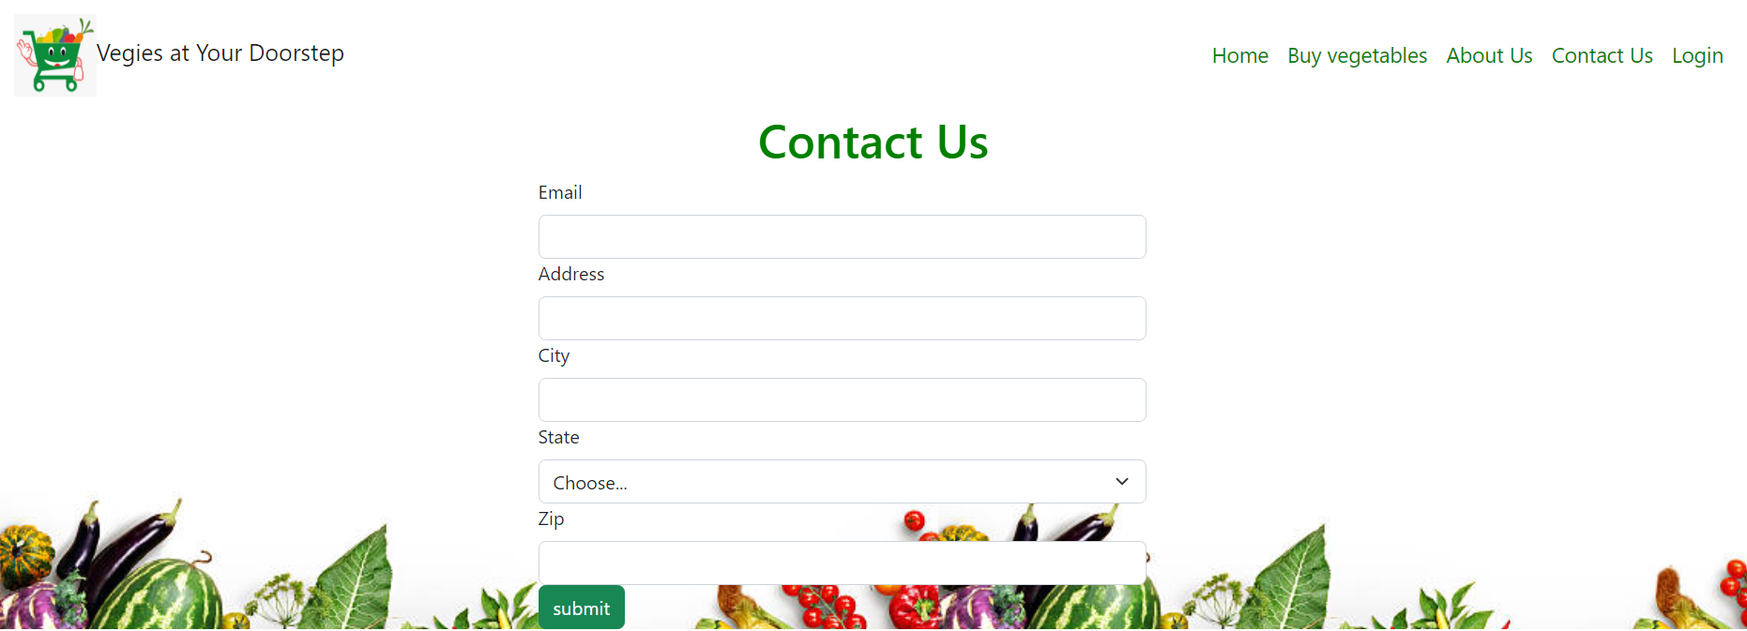
Contact us page

Slide 4
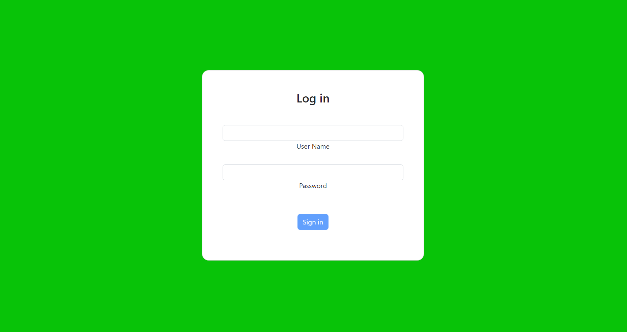
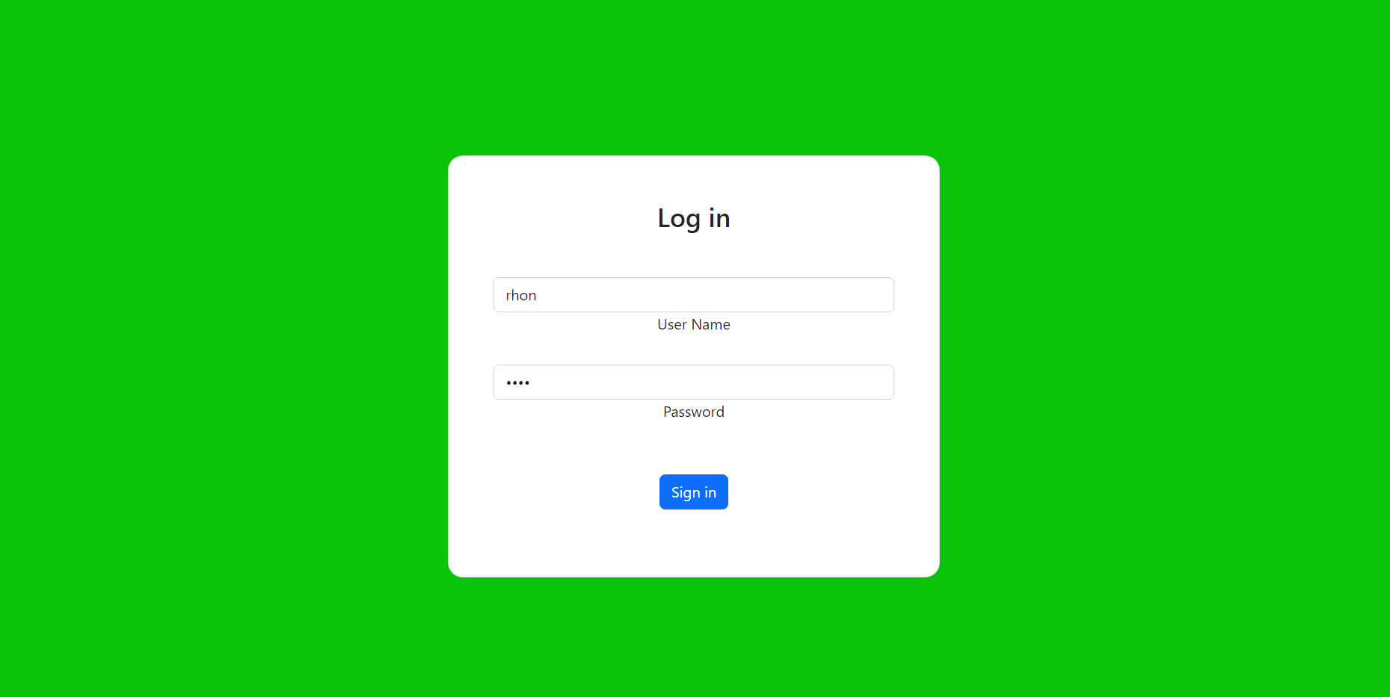
Login Page

Slide 5
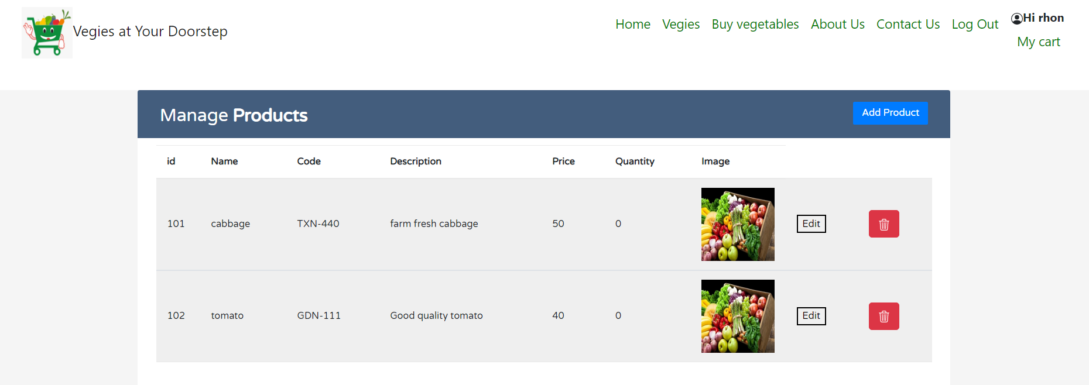
Veges page (Veges add, edit and delete can be performed by admin login only. User can only purchase by adding the veges to cart)

Slide 6
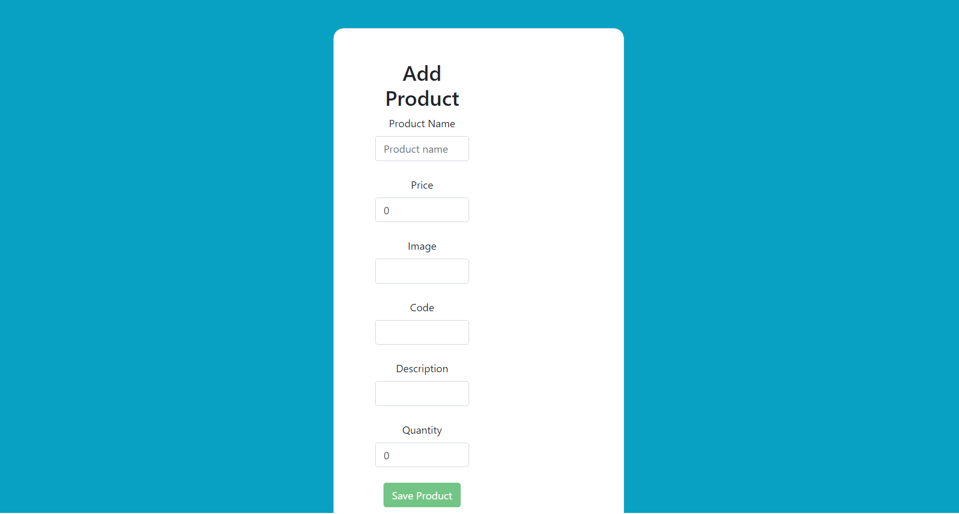
Product crud[Add Product]

Slide 7
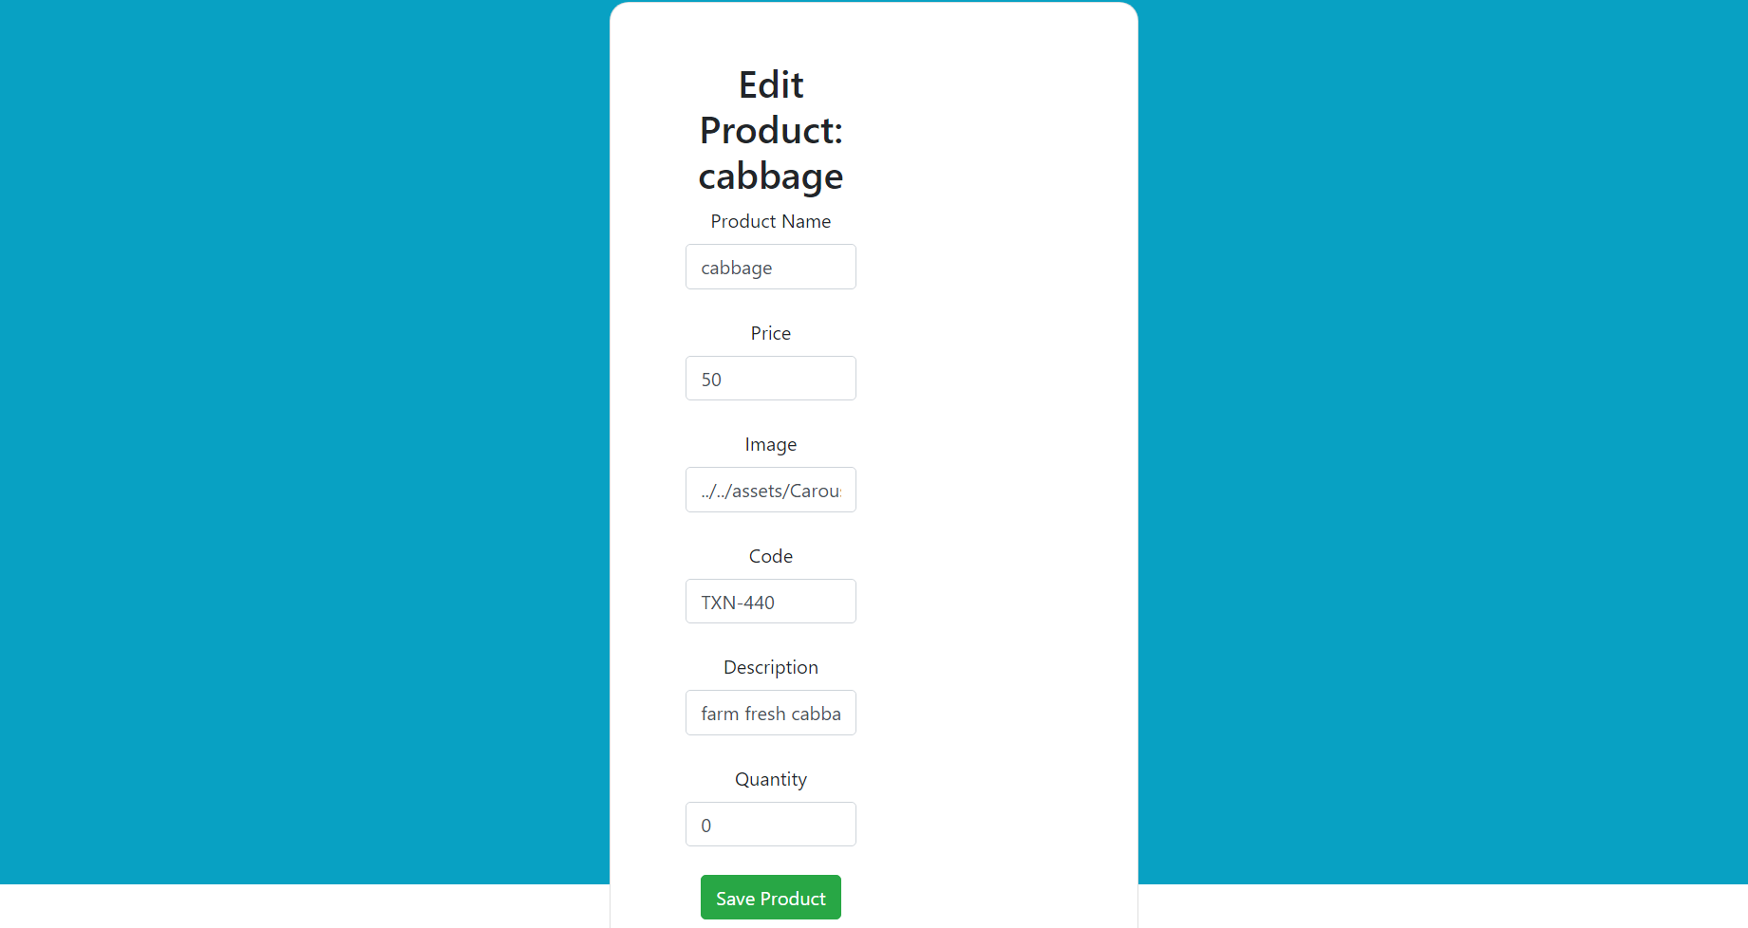
Edit Product (we can able to edit the name, image, description ,code and price of that particular veges)

Slide 8
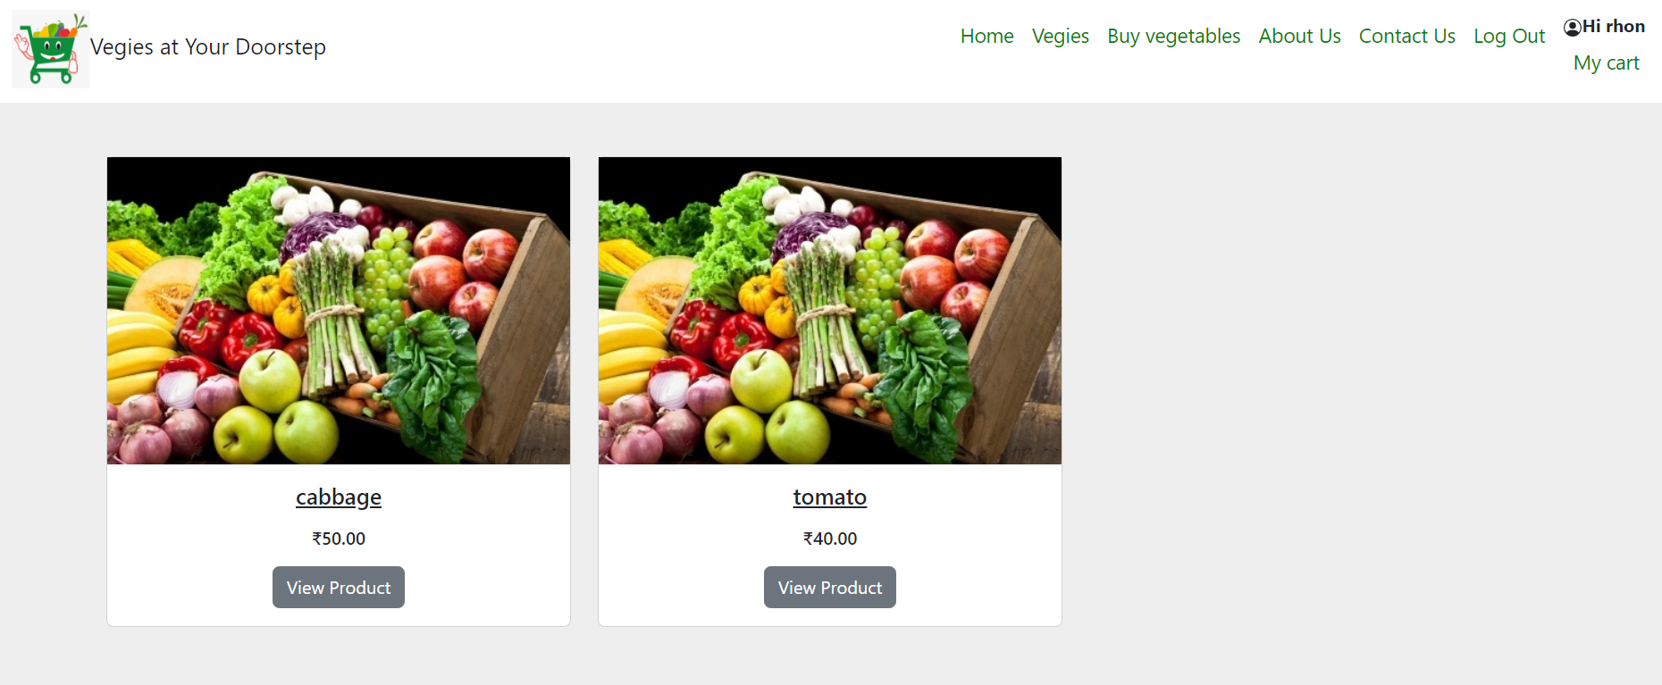
Customer view of products

Slide 9
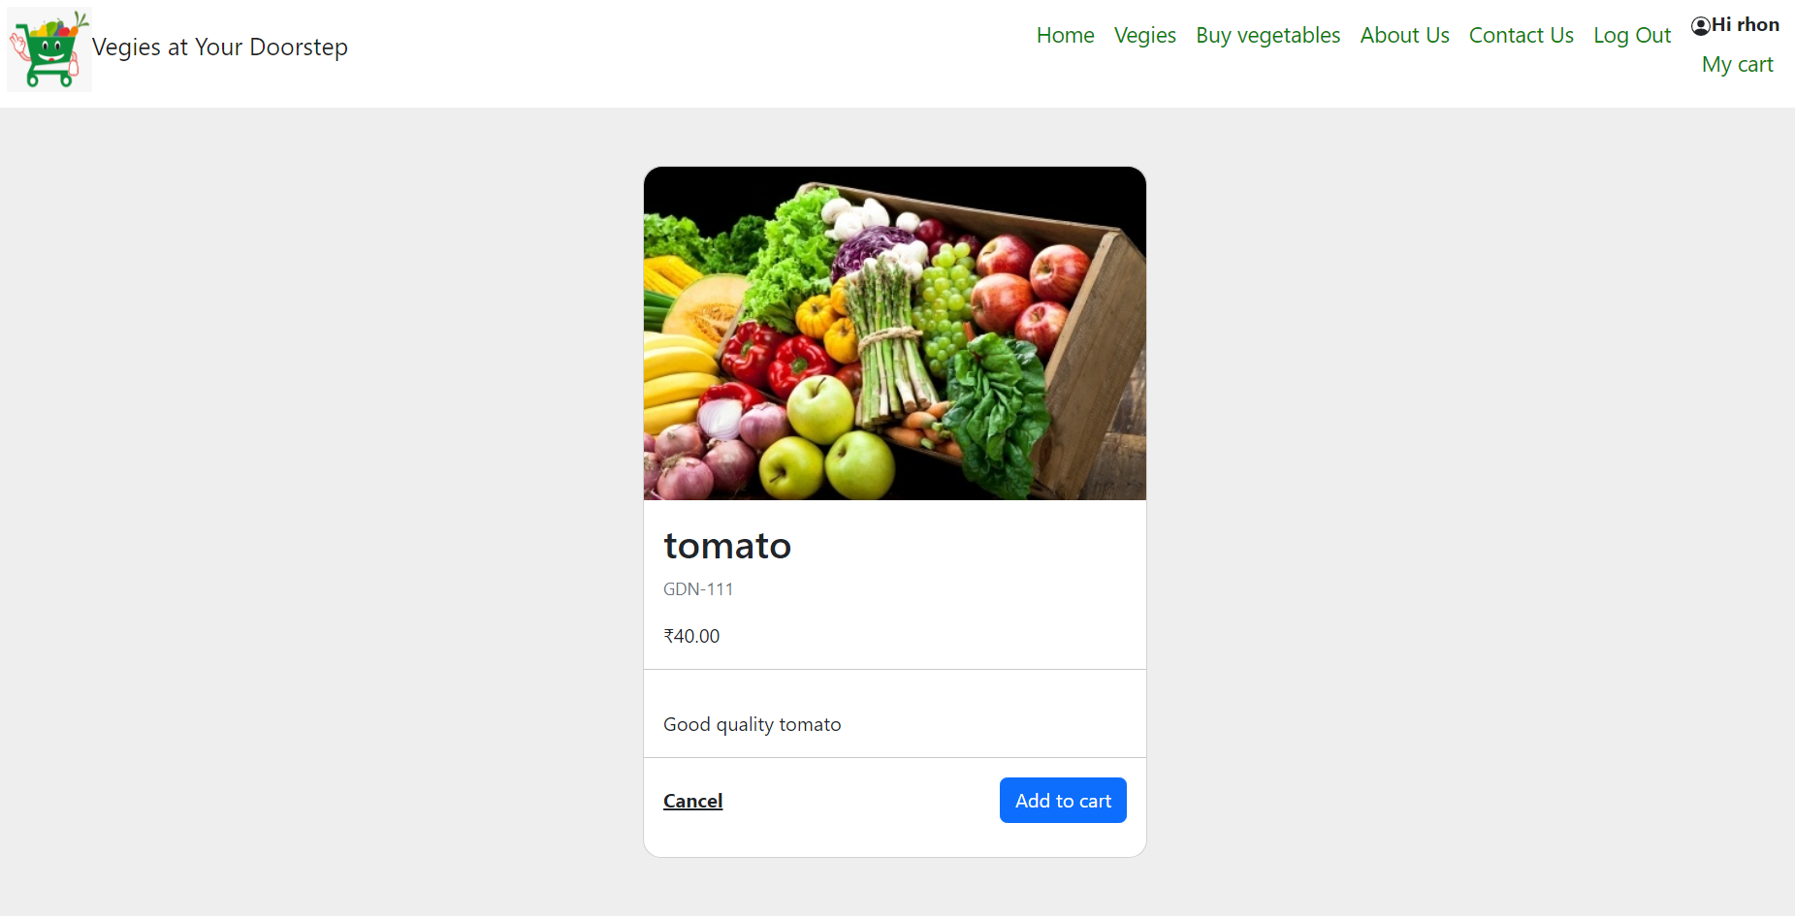
Detailed product view

Slide 10
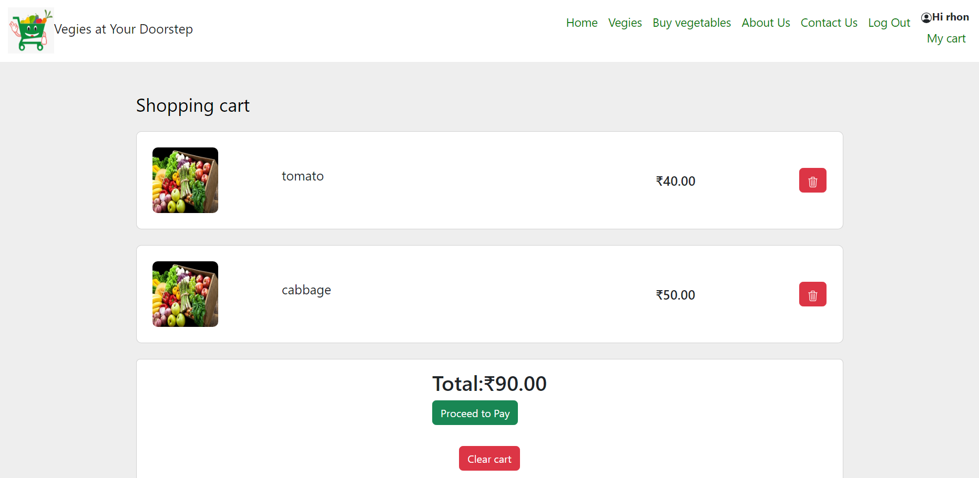
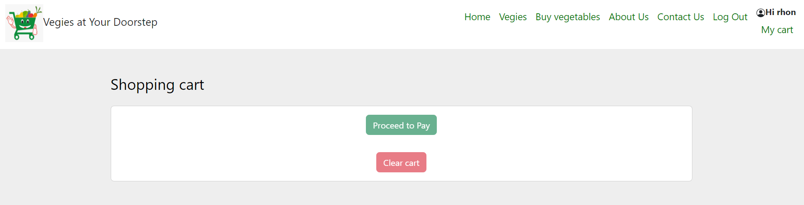
Cart page [when the product is not added checkout button is disabled]

Slide 11
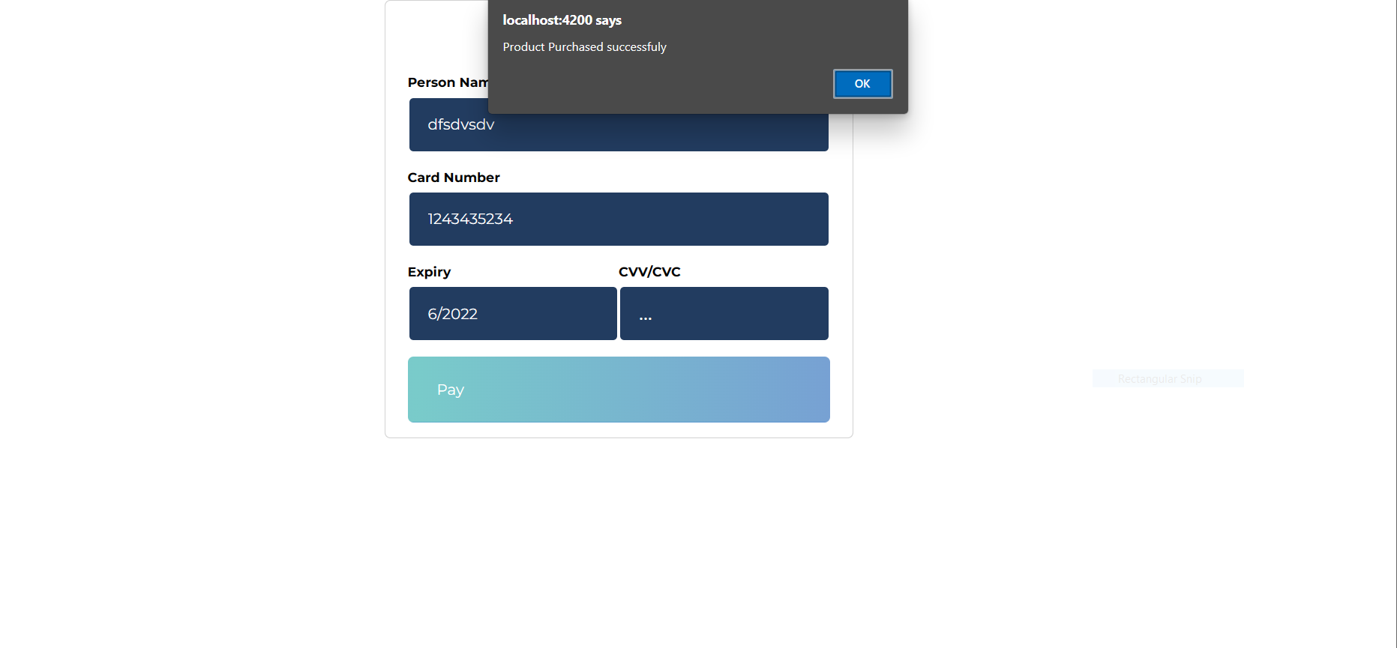
Checkout page (payment details are given and submitted, alert box pops as payment successful)

Slide 12
THANK YOU

